Slide 1
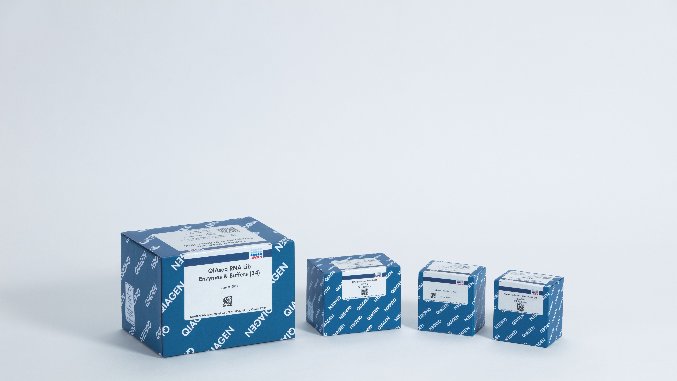
UPXome QC Summary
Tyler Nguyen, Jory Curry, Jason O’Brien – June 2023

Slide 2
QIAGEN Upstream Trimming and Filtering
Post Trim/Filter
Paired Mapping
Total RNA Mapping
Average reads per sample
4.5M
Average trimmed reads per sample
4.2M
Average paired reads per sample
3.8M
Average paired reads per sample
1.04M

Slide 3
Ribosomal Contamination
Top 10 genes accounted for 54% of the total read count
Among those, 8 were rRNA related. Those accounted for 47% of the total read count

Slide 4
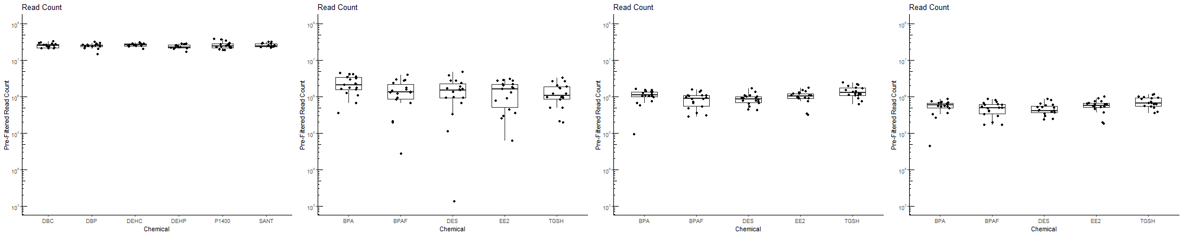
Read Count
Number of mapped reads
3 million read mark
Average was < 1M reads after rRNA removal
Whole Transcriptome Sequencing Previous 3’ UPX Sequencing UPXome Sequencing UPXome w. rRNA Removal

Slide 5
Read Count
Read counts were generally lower (due to exon mapping) with a much better between sample consistency when compared to the 3’UPX samples.

Slide 6
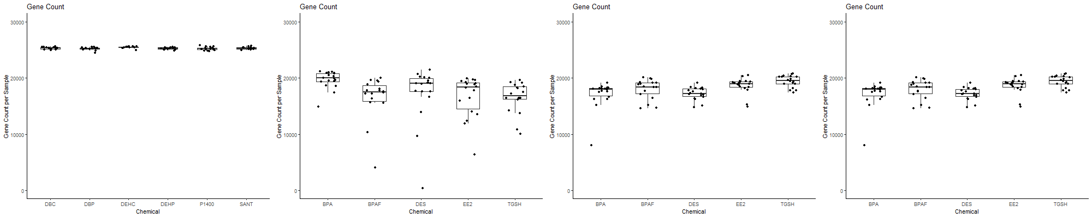
Gene Count
Number of mapped genes with at count of at least 1
Whole Transcriptome Sequencing Previous 3’ UPX Sequencing UPXome Sequencing UPXome w. rRNA Removal

Slide 7
Gene Count
Gene counts showed a small improvement in number and much better between sample consistency

Slide 8
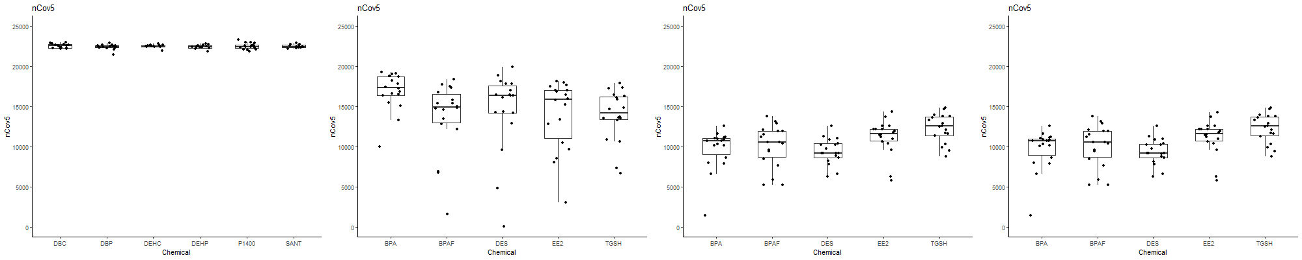
nCov5
Number of genes with a count of at least 5
Genes with count lower than 5 are generally filtered before differential expression analysis
Whole Transcriptome Sequencing Previous 3’ UPX Sequencing UPXome Sequencing UPXome w. rRNA Removal

Slide 9
nCov5
Number of usable genes slightly decreased (due to a lower effective read depth) but were much more consistent between samples.

Slide 10
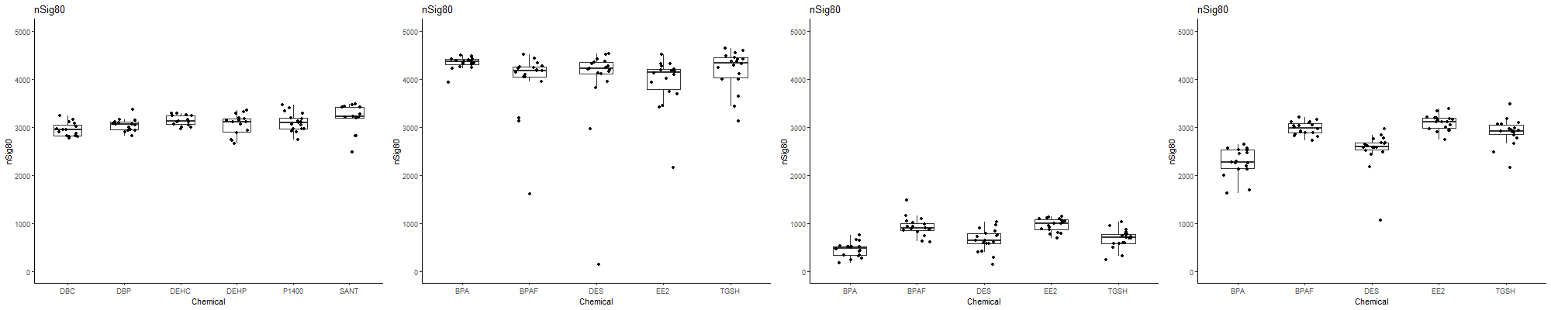
nSig80
Number of the highest expressing genes that represent 80% of mapped reads
A good metric for determining how evenly distributed the reads are within the transcriptome
Whole Transcriptome Sequencing Previous 3’ UPX Sequencing UPXome Sequencing UPXome w. rRNA Removal

Slide 11
nSig80
Read distribution was much poorer (due to a lower effective read depth). The removal of rRNA reads resulted in a much a better read distribution but still not as high as the original 3’ UPX sequencing run

Slide 12
Key Points
New UPXome kits resulted in results that were much more consistent compared to the 3’ UPX kits
High number of raw reads were successfully mapped but intergenic mapping and rRNA contamination resulted in slightly lower-than-expected usable reads
Removal of rRNA still resulted in fewer than expected usable genes for differential analysis.

Slide 13
Moving Forward
Is there any way to reduce intergenic mapping?
Is the full concentration of FastSelect required for rRNA removal? What is the efficacy of a 10x dilution?
Is there any way to prevent the FastSelect from reducing our final library yield?
Can the total RNA be increased from 10ng to 100ng?
How “representative” is a 10ng sample of the transcriptome when it represents ~1000 cells?

